Slide 1
Week 6
Ben Jonson, The Masque of Blackness, Volpone
John Webster, The Duhcess of Malfi

Slide 2
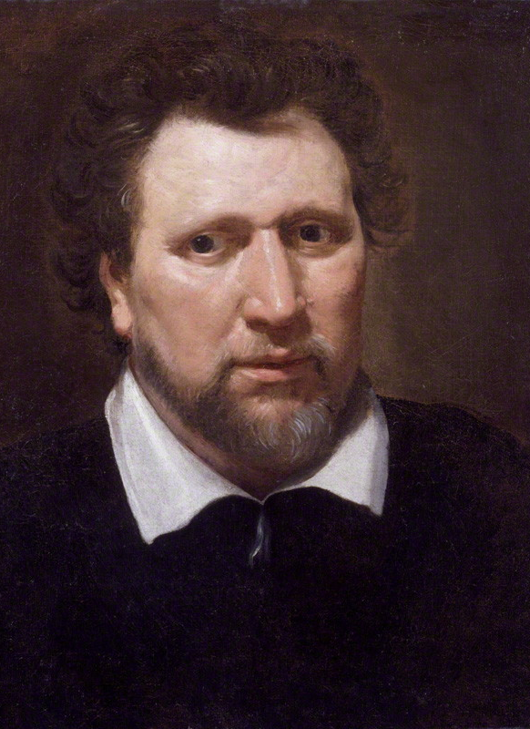
Ben Jonson (1572-1637)
He knew and admired John Donne and William Shakespeare
Works is his first famous writing
Unofficial poet laurete
Pension from the king
Honorary degrees from Oxford and Cambridge
His early life was tough and turbulent
Had to leave school for Money
He joined the army
Jailed for a play too scandalous.

Slide 3
Killed an actor in a duel
His popularity grew with James I
He was questined for his play Sejanus
Jailed for Eastward Ho which mocked the king’s Scottish accent and his selling of titles for money.
The Masque of Blackness was his first play in the court.
Every Man in His Humour
Volpone (1606), The Alchemist (1610), Bartholomew Fair (1614)
Converted to Catholicism than to Church of England
«War of the Theatres»
Colloborations and rivalry in theatre

Slide 4
He died in 1637.
Friends with Shakespeare, Donne, and Francis Bacon
«Sons of Ben» Herrick, Carew, Suckling
Patrons: Lady Mary Wroth, Sir Walter Raleigh, Families of Sidney and Herbert
To Penshurst, a celebration of Robert Sidney’s country house
Classical inspirations
He wrote almost in all genres with a wide imagination

Slide 5
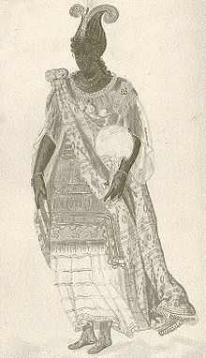
The Masque of Blackness

Slide 6
James I and Queen Anne and their court
Court masque as praise, entertainment, political idealization
Stuart court as the embodiment of all perfections
Colloboration with Inigo Jones
Feasts, wedding, celebration, all night dancing
Costumes
Criticism against this was punished: William Prynne

Slide 7
Themes of the play
The cultural superiority of the English over non-European people
Celebrates the reign of King James, «Sun King» of Britain
James I can turn black skins to white
Orientalism and the women
Jacobean masques, glorification of the monarch
Jonson invented the prologue
Music, costume, design, songs etc.
Utter racism

Slide 8
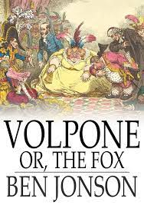
Volpone (1606)
A dark satire on human greed
Set in Venice
The target is City of London
Commerce, corruption
Greedy fools and rascals
Money economy and its effect on the human, theatre, writing and other aspects of social life.
Commercial interest

Slide 9
«In Volpone Jonson protests the inhumanity of greedy poeple and laws – laws made by the greedy to protect the acquisitions of the greedy»
The state of Venice is more criminal than the criminals itself
A mix of themes from various sources
Rich old man mocking the other rascals who are after his inheritance.
Reynard the Fox – Volpone
Mosca – the parasite
Voltore – lawyer
Corbaccio – avaricious dotard (greedy old man)
Roman comedy characters

Slide 10
First performed by the King’s Men (Shakespeare’s company)
Globe Theater
Classical unity of action, time and place.
Volpone is an old man faking to be at the end of his life to lure rascals to rob them off their gifts.
Voltore brings an antique plate and is told he will be Volpone's sole heir. Corbaccio and Corvino enter in succession, bringing a bag of gold coins and a pearl, respectively, and are also told that they will be heir to Volpone's fortune.

Slide 11
In the street, Volpone, disguised as a commendatore, torments Corbaccio, Corvino, and Voltore by pretending he has heard news that they inherited a fortune.
After being summoned by the Avocatori, Mosca arrives at the Scrutineo and affirms that Volpone is dead. Volpone beseeches him to say that Volpone is still alive, but Mosca demands half of his fortune. When Mosca and Volpone cannot agree to share the fortune, Volpone is apprehended by officers of the court. Before he is led away, however, Volpone unmasks himself and brings Mosca down with him. The Avocatori then hand down punishments to Volpone, Mosca, and the rest of the "clients." To conclude the play, Volpone speaks to the audience and asks for applause.

Slide 12
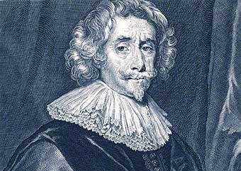
John Webster (1580?-1625?)

Slide 13
The White Devil (1608), The Duchess of Malfi (1614)
Tragedies set in Roman Catholic Italy representing the Jacobean era
Sophisticated corruption and evil characters

Slide 14
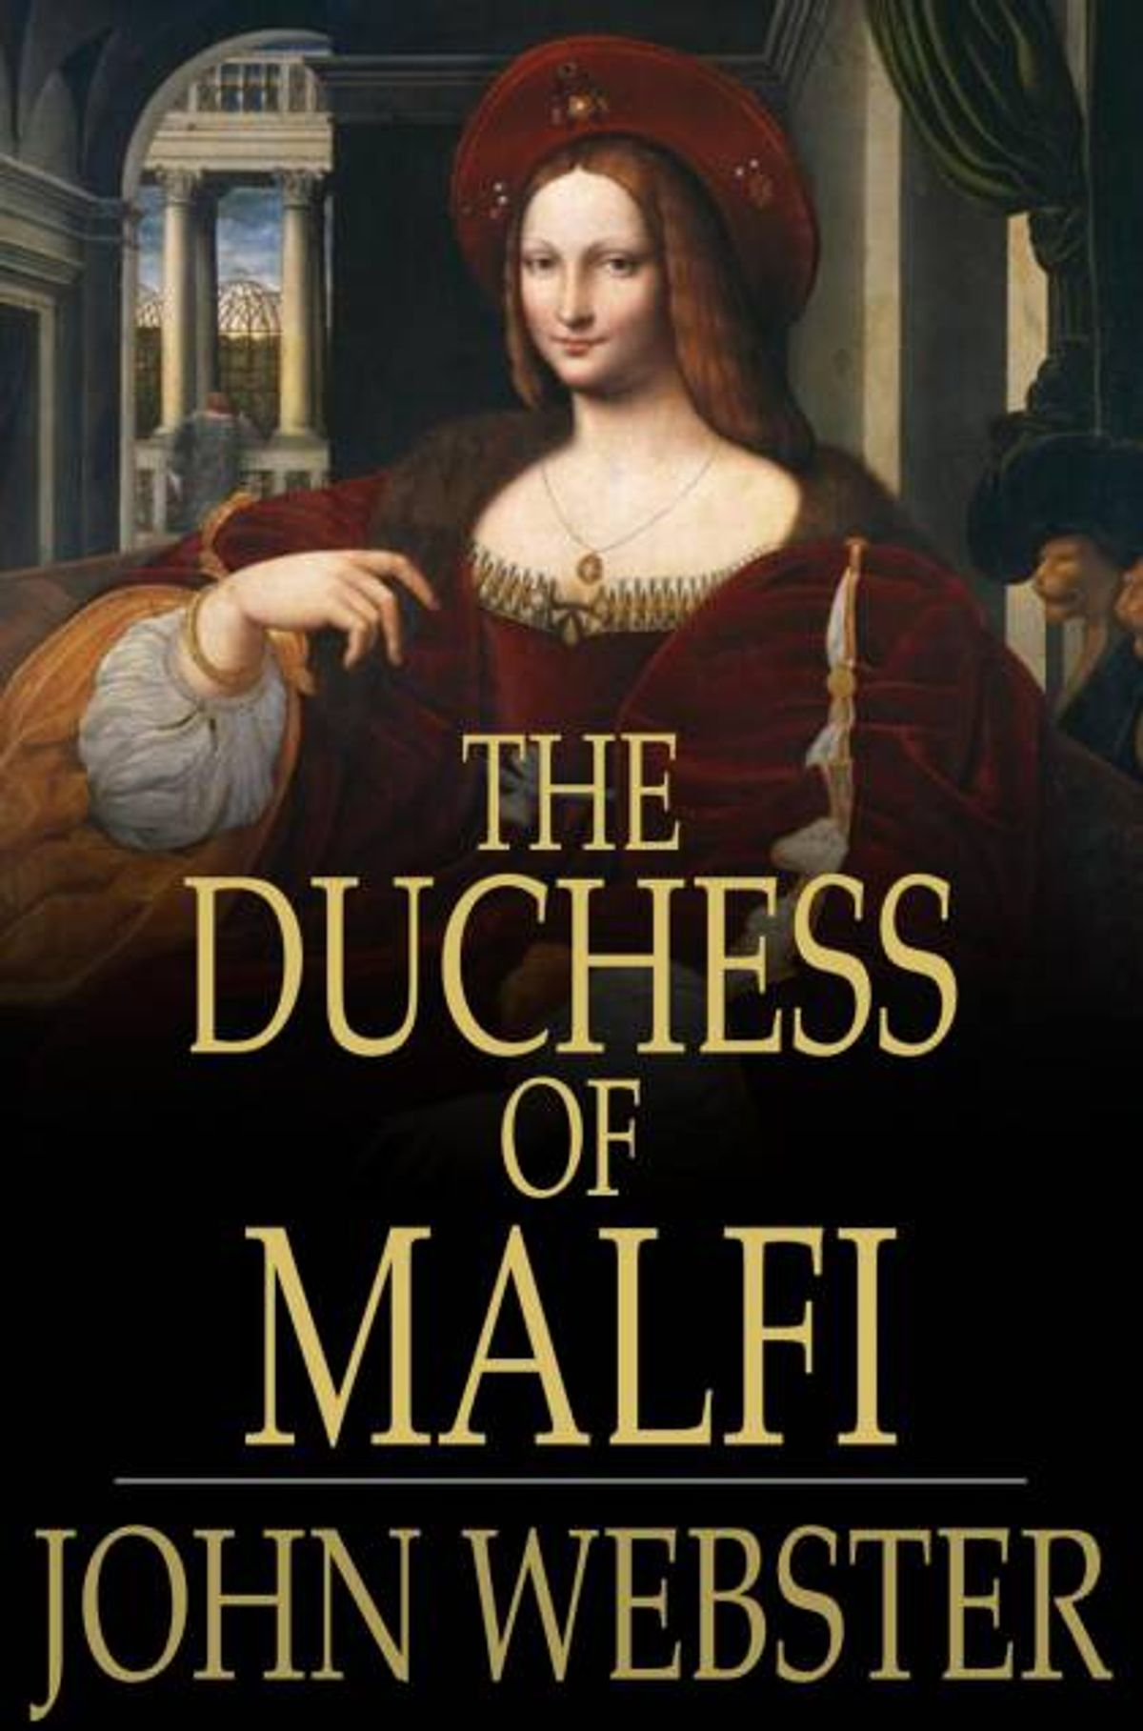
The Duchess of Malfi

Slide 15
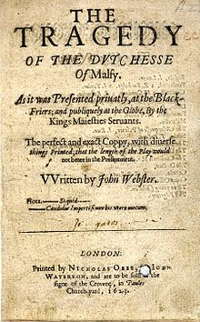

Slide 16
The Duchess of Malfi is based on an Italian novella.
A Jacoean revenge tragedy – Senecan tragedy
Based on a real story from Italy, Amalfi
The Duchess marries Antonio her steward secretly
She defies her brothers commands to stay widow
Poetry, gothic horror
Stage violence
Brothers melancholy
At the end the stage is full of bodies including Duchess, Antonio and their children
Independent spirit and the courage of the Duchess

Slide 17
Class, nobility vs lower classes
The corruption of law and religious authority
Revenge and evil murders
Disguise
The violent past of the Italian peninsula
Politics and lust for power

